Slide 1
Running Data
Dashboard
Alan Castillo, Connor Nelson, Owen DeCleene,
Vani Korepu, Dhruv Keyal

Slide 2
Introduction
The purpose of our project is to investigate statistics, trends, and correlations between various running metrics based on a personal running dataset
Our dashboard includes five types of visualizations that explores four different use cases based on the perspectives of our defined users
Our main goals allow the users to:
Identify trends by selecting attributes to examine over time
Discover correlations between quantitative and categorical data
Notes:
Vani

Slide 3
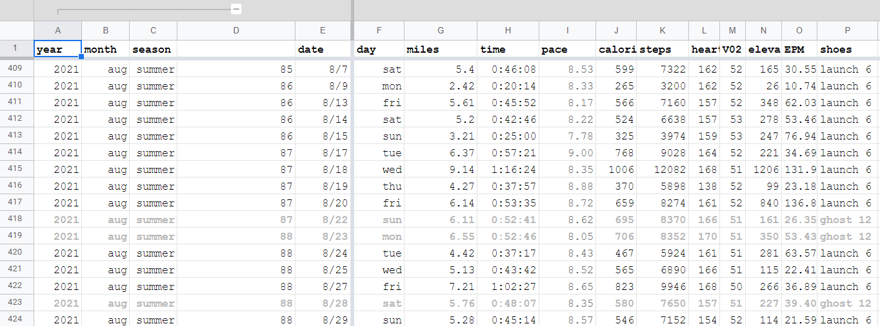
Data Background
Compiled by UMass Amherst undergrad student
Tabular data:
586 items spanning 868 days from Oct 15, 2019 to Feb 13, 2022
Each item contained 36 attributes
We only considered 26 of these attributes
Stored in *.csv file on GitHub

Slide 4
User Groups and Tasks
Amateur Runner
Description: Interest for this user stems from curiosity, especially when it comes to gaining insight into the benefits of running. Analyzing factors such as running partner, weather, shoes, etc. and their relationship to performance is an aspect which will be useful for them.
Tasks:
Tracking progress over time to see a steady improvement in speed, performance and other metrics.
Correlations about attributes that affect the quality of the run
Professional Runner
Description: Consistency and improvement plays a key role in the motivation behind this user applying this dashboard to their performance and daily routine.
Tasks:
Meeting key performance goals by tracking mileage, mental wellbeing, time of day, etc.
Comparing to another professional runner when it relates to terrain and pace

Slide 5
User Groups and Tasks
Sports Scientist
Description: Wants to understand relationships in the data. Goal is to describe the mechanics of running and to develop techniques and technology to improve an athletes performance
Tasks:
Discover correlations that things like VO2 max and heart rate might have with improvement metrics.
Identify relationships between running shoe and physical condition.
Running Coach
Description: A coach manages the progress of a group of runners. They are knowledgeable about how to improve a runner’s performance and track several key metrics to see progress.
Tasks:
Record trends of a runners improvement with attributes like pace and mileage.
Compare and contrast performance between different terrains and race vs practice.

Slide 6

Real-Life User
UMass Amherst undergrad mathematics student
Curious about data tracking & exploration
Visualization literate
Serious amateur runner
Active member of Running Club
Participates in amateur running competitions (5k’s, half-marathons, marathons, etc.)
Values running as part of their physical & mental wellbeing

Slide 7
Demo

Slide 8

User Evaluation
Thoroughly enjoyed using the dashboard
Reinforced known correlations and discovered new trends
Heavily favored lower right visualization
Did not modify Trend/Bar chart
Small learning curve
Asked to update data and use long-term

Slide 9
Questions?

